Slide 1
Biology
Unit 7: Genetics and Heredity
Lesson 2: Mendel and Heredity
Notes:
Lesson Objective: Ask questions about the role of genes and the environment in coding for traits that are passed down from parents to offspring.

Slide 2

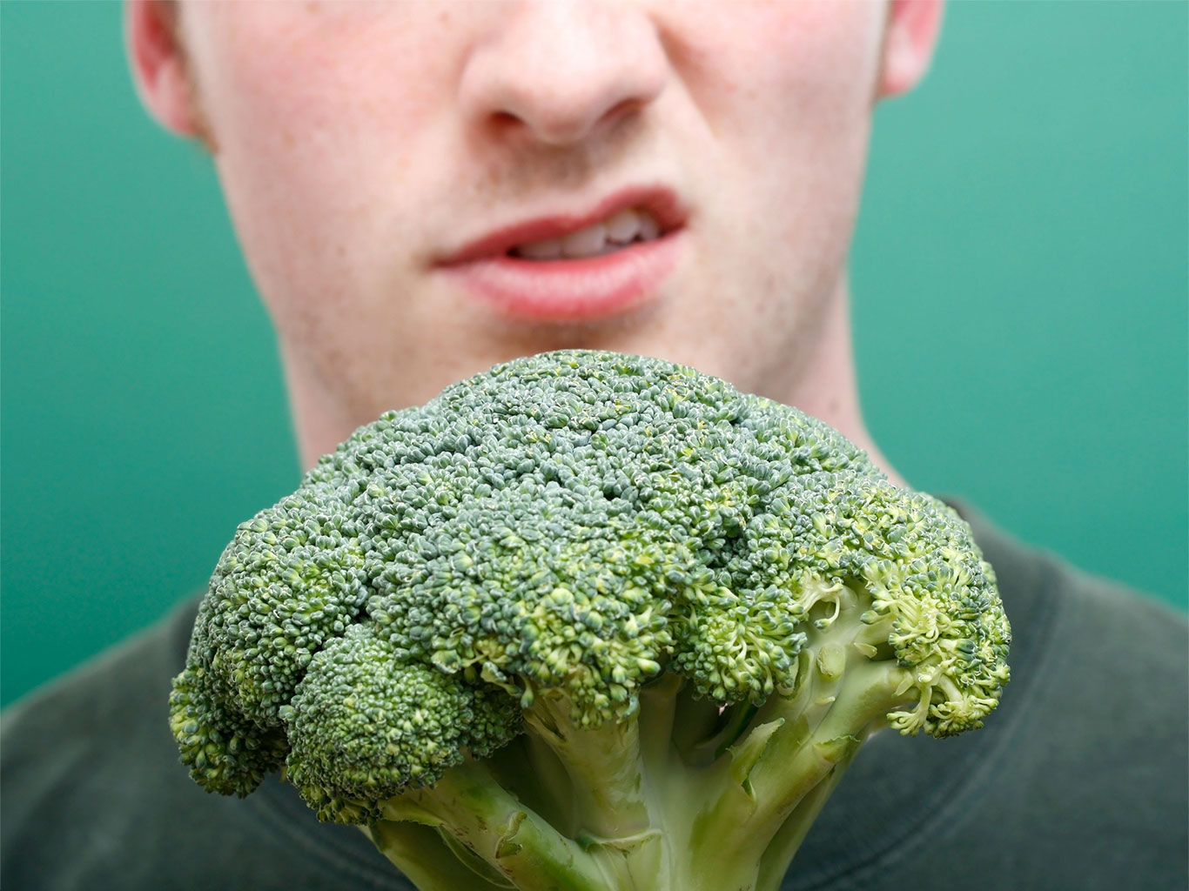
Can You Explain It?
Unit 7 Lesson 2
Do you think food preferences are passed down from parents to their children, or does the environment play a role? Explain your answer.

Slide 3
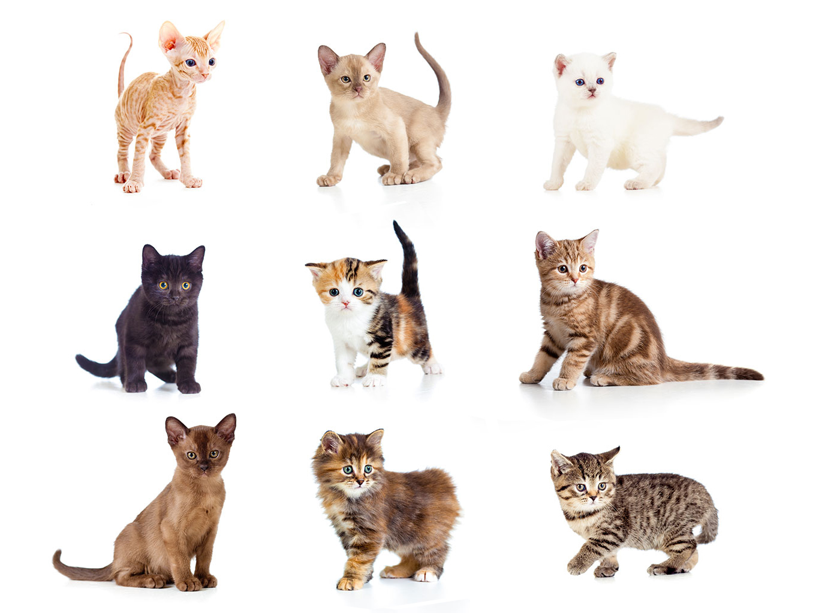
Mendel’s Groundwork for Genetics
Unit 7 Lesson 2
One of the most important outcomes of sexual reproduction is the variety in traits that results from a shuffling of genes.
These traits are distinguishing characteristics that are inherited.

Slide 4

Mendel’s Groundwork for Genetics Hands-On Lab: Investigating Traits and Heredity
Unit 7 Lesson 2
Plan and conduct an investigation to determine how albinism is inherited in tobacco plants.

Slide 5
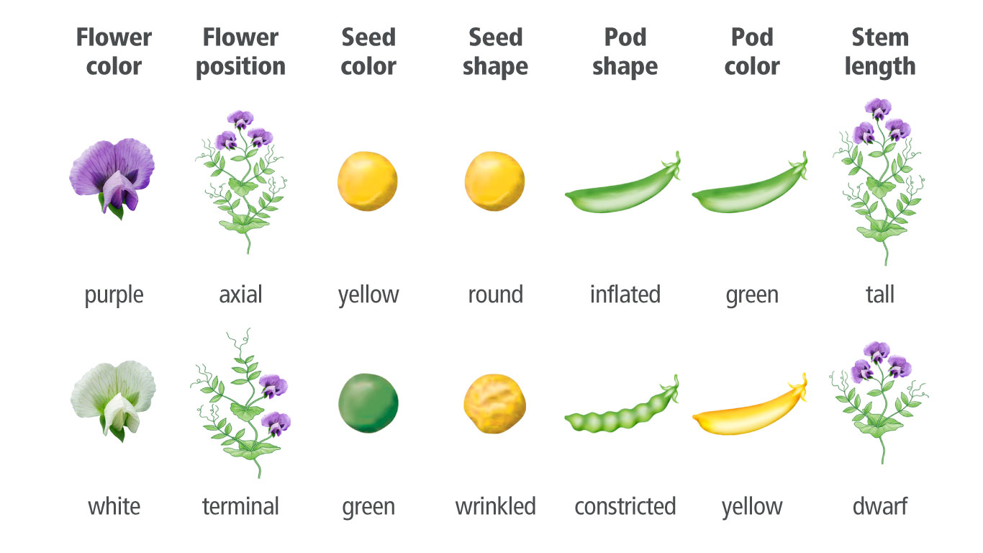
Mendel’s Groundwork for Genetics
Unit 7 Lesson 2
A genetic cross is the mating of two organisms.
When Mendel pollinated a specific female flower of a plant with the pollen from another plant, he carried out a cross.

Slide 6
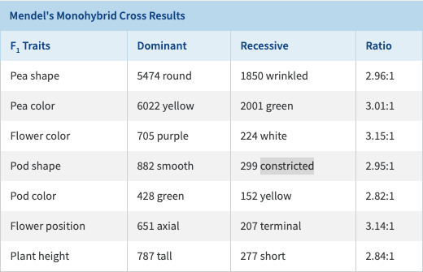
Mendel’s Groundwork for Genetics
Unit 7 Lesson 2
What patterns do you notice in Mendel's data?

Slide 7
Mendel’s Groundwork for Genetics
Unit 7 Lesson 2
EXPLAIN
During anaphase I of meiosis, copies of the same gene are separated as homologous chromosomes move to opposite sides of the cell. These chromosomes may or may not contain the same genetic information. Use evidence from meiosis to explain how gene separation occurs and why gametes have only one copy of each gene. How does the process of meiosis support the Law of Segregation?

Slide 8
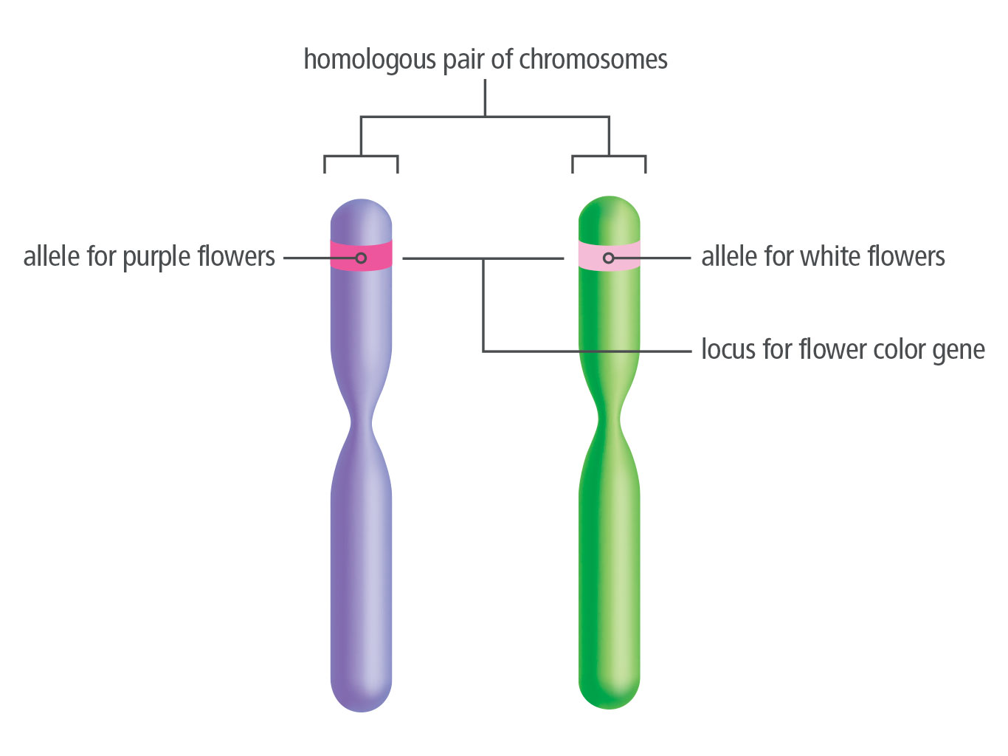
Traits, Genes, and Alleles
Unit 7 Lesson 2
A gene is a piece of DNA that provides a set of instructions to a cell to make a certain protein.
An allele is any of the alternative forms or versions of a gene that may occur at a specific locus.

Slide 9
Traits, Genes, and Alleles
Unit 7 Lesson 2
Your body cells contain two alleles for each gene.
The term homozygous describes two of the same alleles at a specific locus.
The term heterozygous describes two different alleles at the same locus.
For example, you may inherit an allele for freckles from one parent and another allele for no freckles from your other parent.

Slide 10
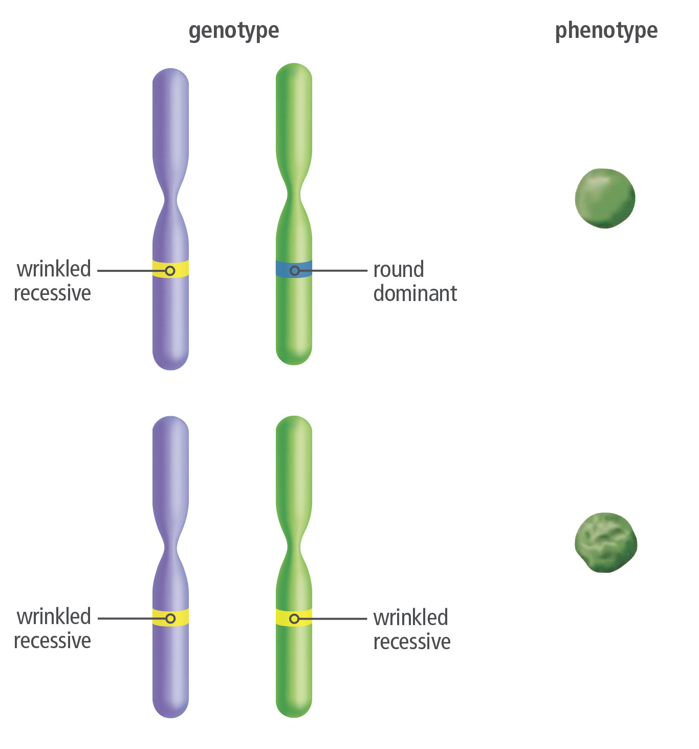
Traits, Genes, and Alleles
Unit 7 Lesson 2
When describing homozygous or heterozygous pairs of alleles, we are referring to an organism's actual genetic makeup. This is known as its genotype.
The actual physical characteristics, or traits, of an individual make up its phenotype.

Slide 11
Traits, Genes, and Alleles
Unit 7 Lesson 2
A dominant allele is the allele that is expressed when two different alleles or two dominant alleles are present.
A recessive allele is the allele that is only expressed when two recessive copies occur together.
Write two questions you could ask to learn more about how food preferences, such as distaste for broccoli, are passed from parents to offspring.

Slide 12
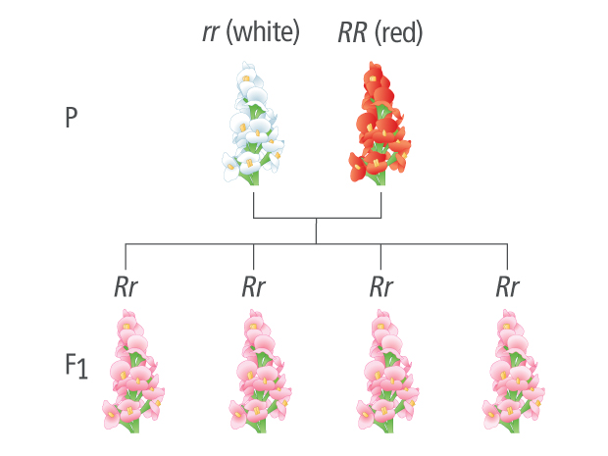
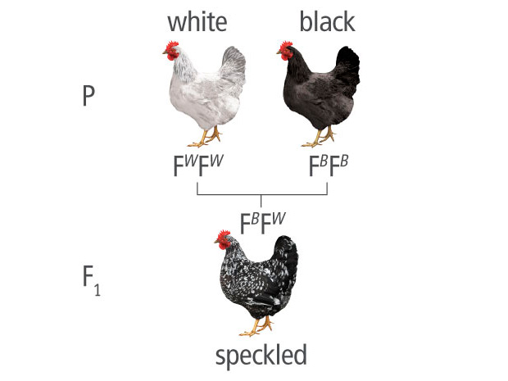
Extending Mendelian Genetics
Unit 7 Lesson 2
Sometimes alleles show incomplete dominance, in which a heterozygous phenotype is somewhere between the two homozygous phenotypes.
These alleles show codominance, and both traits are fully and separately expressed.

Slide 13
Extending Mendelian Genetics
Unit 7 Lesson 2
EXPLAIN
The gene for red-green color blindness is located on the X chromosome. Based on what you have read about sex chromosomes, does the mother or father pass the gene for color blindness to sons? Explain your answer.

Slide 14
Extending Mendelian Genetics
Unit 7 Lesson 2
Your height is an example of a polygenic trait, in which multiple genes contribute to the overall phenotype observed.
Genes that modify the expression of another gene are said to show epistasis.

Slide 15
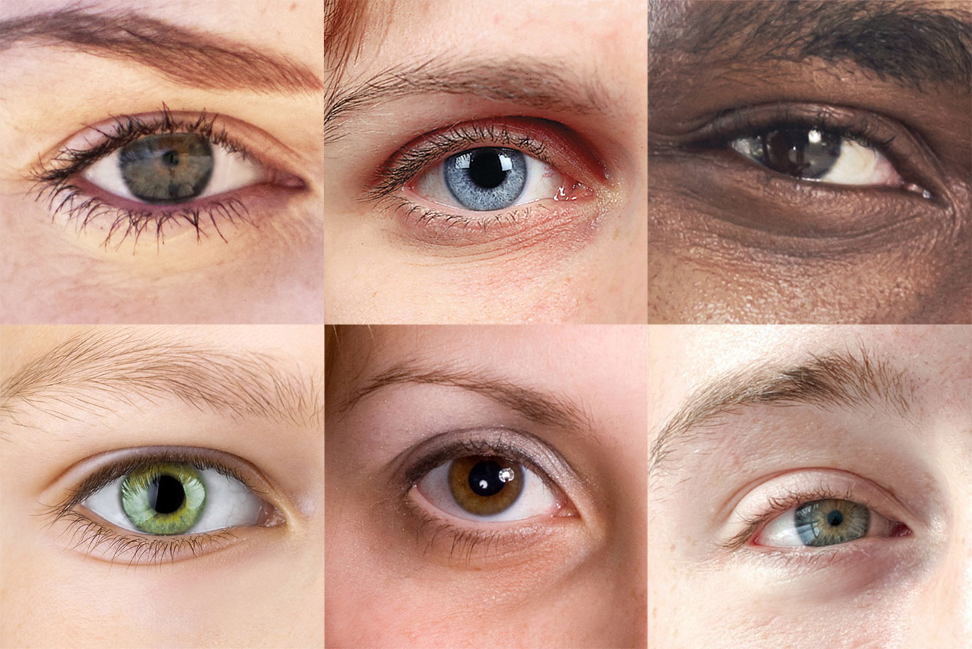
Extending Mendelian Genetics Cause and Effect
Unit 7 Lesson 2
A child inherits a dominant allele of the OCA2 gene from his mother and a mutated version of this gene from his father. Based on this information, what would you predict about the color of this child's eyes?

Slide 16
Unit 7 Lesson 2
Continue Your Exploration
Choose one of the paths below to continue your exploration:
Genomics: Studying Genomes
Evaluating Claims: Eye Color and Our Ancestors
Discussion: Sequencing Your Own Genome

Slide 17
Can You Explain It?
Unit 7 Lesson 2
When it comes to something like food preferences, how do genetics and the environment influence traits? Refer to the notes in your Evidence Notebook.
How are traits generally passed from parents to offspring?
How can dominant-recessive relationships influence which trait is expressed in the phenotype of the organism?
How is the expression of genes influenced by other genes and the environment?

Slide 18
Image Credits
Unit 7 Lesson 2
teen students using computer ©E+/Steve Debenport/Getty Images; man disliking broccoli ©Lasse Kristensen/Alamy; kittens ©Andrey Kuzmin/Fotolia; eyes, close ups ©PeopleImages/iStock/Getty Images Plus

